Slide 1
Chongqing University of Technology
ATAI
Advanced Technique of Artificial Intelligence
Chongqing University of Technology
Multi-Channel Pooling Graph Neural Networks（IJCAI 2021 ）
彭展望
Code:https://github.com/kingloon/MultiChannelPooling

Slide 2
Outline
Introduction
Related Work
Method
Experiment
Conclusion

Slide 3
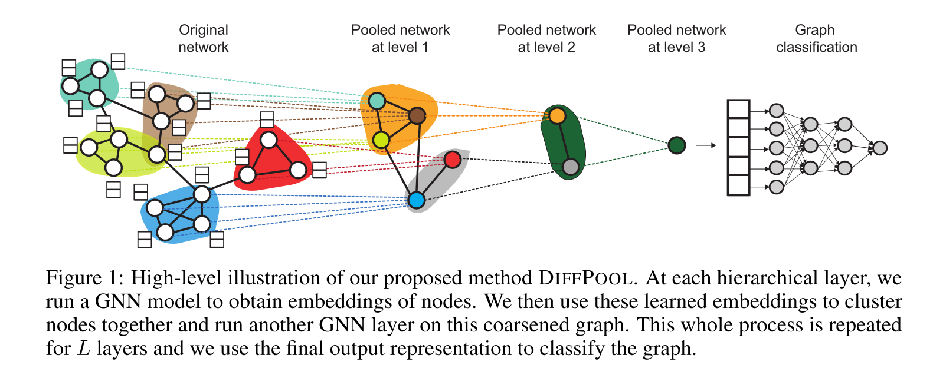
Introduction
论文：Hierarchical Graph Representation Learning with Differentiable Pooling （NIPS 2018）
$$W^{(k−1)}∈ℝ^{{d×n}_{l+1}}$$
$$A^{l}∈ℝ^{n_{l}×n_{l}}$$
$$X^{l}∈ℝ^{n_{l}×d}$$
$$Z^{l}∈ℝ^{n_{l}×d}$$
Notes:
$$W^{(k−1)}∈ℝ^{{d×n}_{l+1}}$$

Slide 4
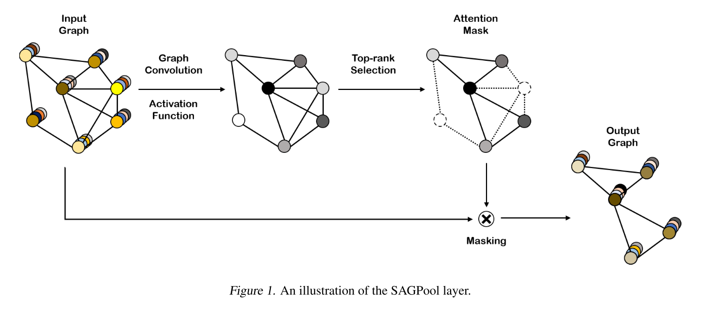
Introduction
论文：Self-Attention Graph Pooling（ICML 2019）
$$Z∈ℝ^{N}$$
Notes:
$$Z∈ℝ^{N}$$

Slide 5
Graph Convolution Networks

Slide 6
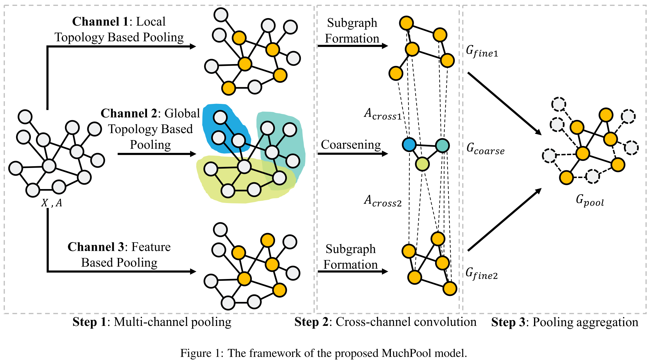
Method
Step 1
Channel 1: Local topology based pooling
Notes:
Step

Slide 7
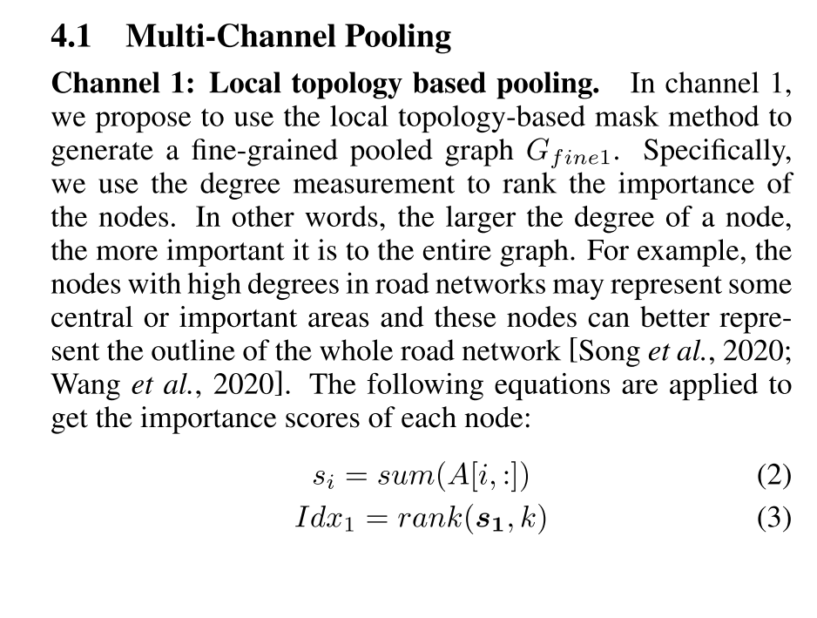

Slide 8
Method
Step 1
Channel 2: Global topology based pooling.

Slide 9
Method
Step 1
Channel 3: Node feature based pooling.

Slide 10
Method
Step 2
Cross-Channel Convolution

Slide 11
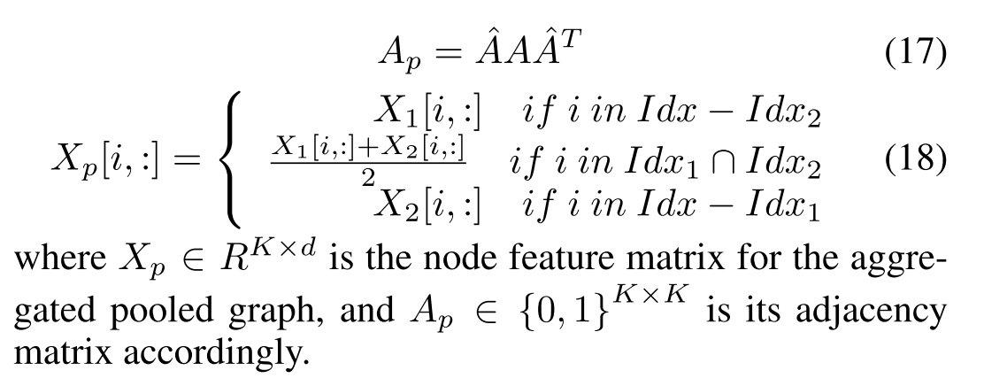
Method
Step 3
Cross-Channel Convolution

Slide 12
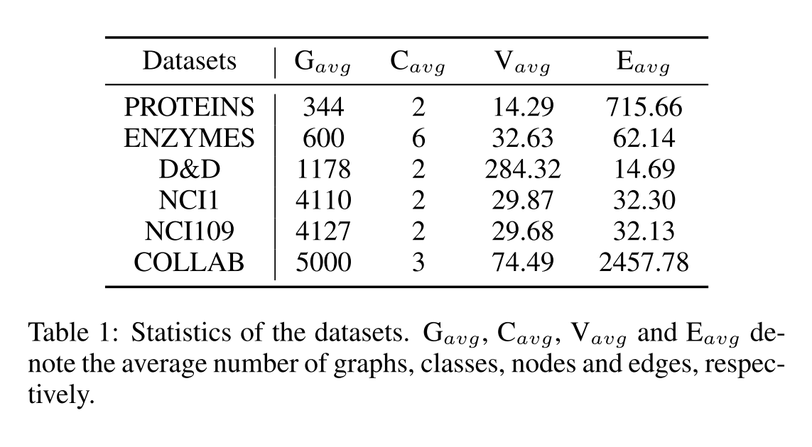
Dataset

Slide 13
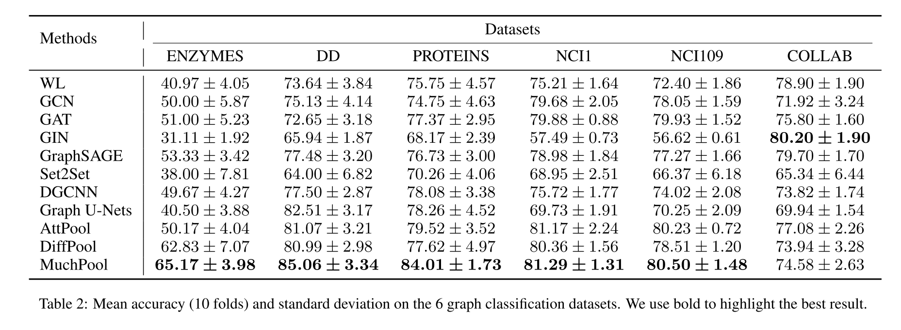
Experiment

Slide 14
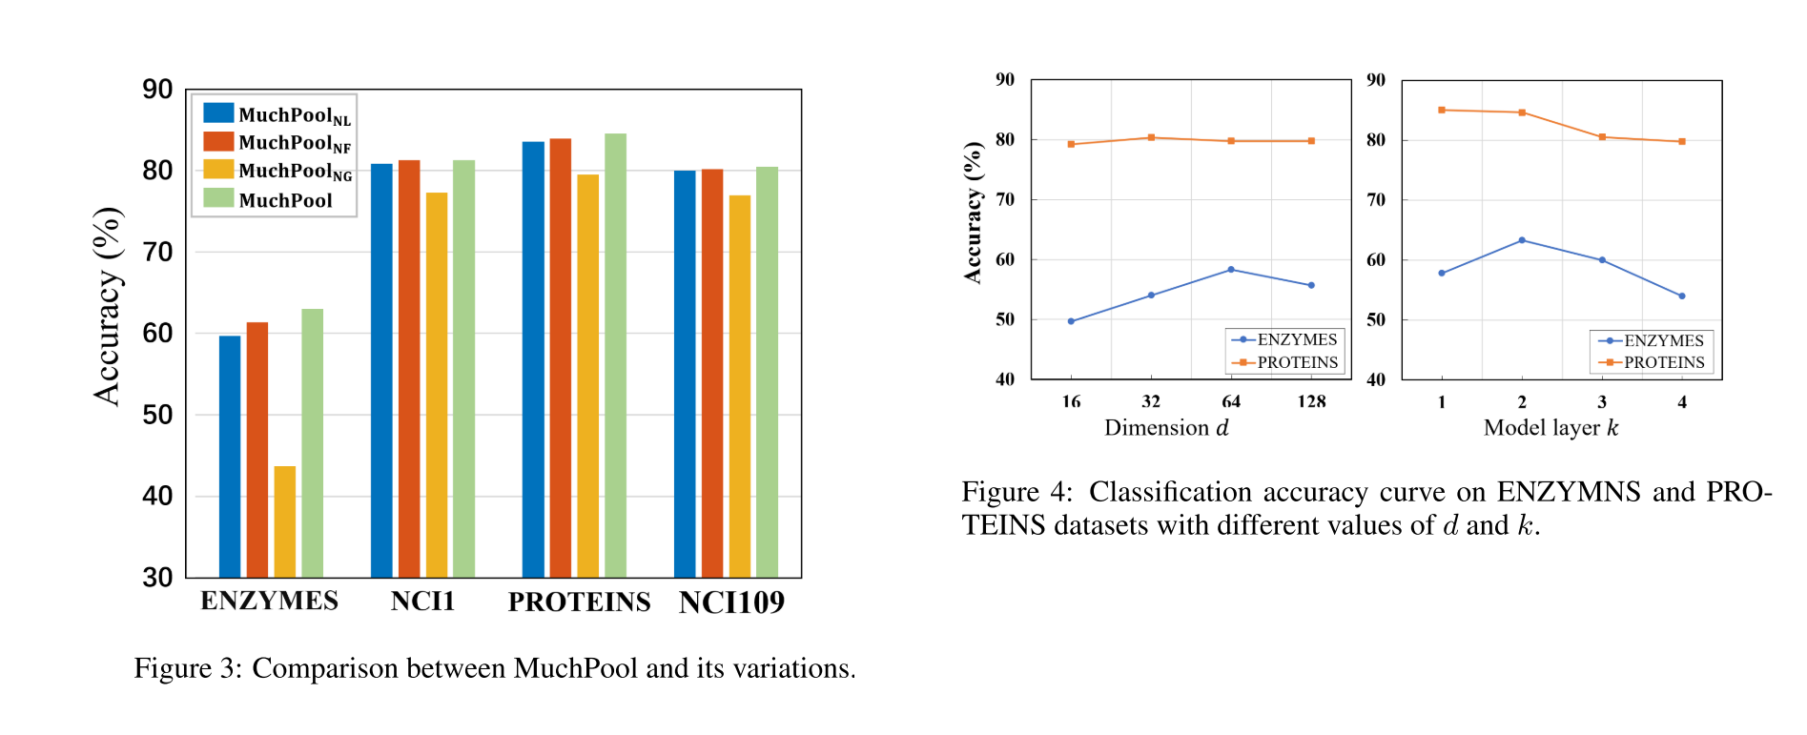
Experiment

